Slide 1



AI Testing – Testing Quality Assessment
Presented by: Jerry Gao, Professor, and Director
San Jose State University – Excellence Research Center on
Smart Technology, Computing, and Complex Systems
Date: 6/4/2018

Slide 2







AI System Testing Quality Parameters
AI Function
Feature Accuracy
AI Function
Completeness
AI Function
Relevancy
AI Function Feature
Consistency
AI Function
Feature Correctness
AI Currency
AI Currency

Slide 3
AI Software Test Modeling
AI-Software
F1
Fk
Fn
AI knowledge test model
AI feature test model
Object test model
Data test model
Ai feature set (AiF)
F-s1
F-si
F-sm
Ai sub-feature set
T1
Tm
Test sets

Slide 4
AI Software Test Modeling
Identifying Object Class
Object Under
Different
Contexts
Different
Object
Attributes
Identifying
Sub-class
Identifying
Incorrect
Objects
Identifying
no objects
Object In Different Backgrounds
Object
Class #1
Attribute
Class #1
Object
Class #k
Attribute
Class #k
Object In
Different
Lighting
Object
Class #i
Attribute
Class #i
Object In
Different
Weather

Slide 5
AI Software Test Quality Assessment
AI-Software
Timeline
%
Accuracy
%
Correctness
%
F1
Fk
Fn
Ai feature set (AiF)
F-s1
F-si
F-sm
Ai sub-feature set
QF
Consistency
%
Completeness
%
F-si
(TC)
Quality factor set (QF)
Test Complexity(TC)
Qf1
Qfj
TC(T1)
TC(Tm)
Quality
factor set (QF)
T1
Tm

Slide 6
AI Software Test Adequacy and Coverage
AI-Software
AI knowledge model test coverage
AI feature test coverage
Ai sub-feature test coverage
AI feature classification test coverage
Object-model test coverage
Object classification test coverage
Object context test coverage
Object relation test coverage
Data-model test coverage
Data classification test coverage
Data relation test coverage
Data format test coverage
Data range test coverage
F1
Fk
Fn
Ai feature set (AiF)
F-s1
F-si
F-sm
Ai sub-feature set
F-si
(TC)
Test Complexity(TC)
Qf1
Qfj
TC(T1)
TC(Tm)
Quality
factor set (QF)
T1
Tm

Slide 7
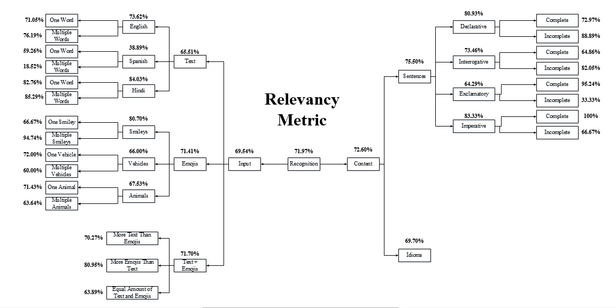
AI System Testing – A Case Study – Google Allo
Total Relevancy (%): 71.97%
100 x (Acceptable Replies / Total Replies) = 570 / 792
Same formula applies to all nodes

Slide 8
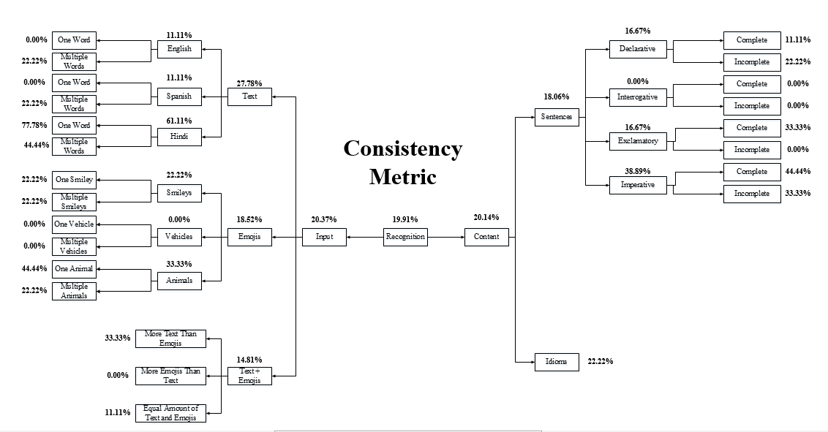
AI System Testing – A Case Study – Google Allo
100 x (Total number of consistent test cases/ Total number of consistent test
cases + Total number of inconsistent test cases )=43/216
So we got Consistency as 19.91%

Slide 9
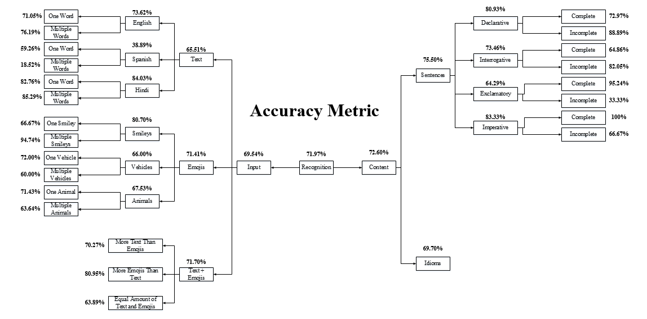
AI System Testing – A Case Study – Google Allo
Total Accuracy (%): 71.97%
100 x (Acceptable Replies / Total Replies) = 570 / 792
Same formula for all nodes

Slide 10
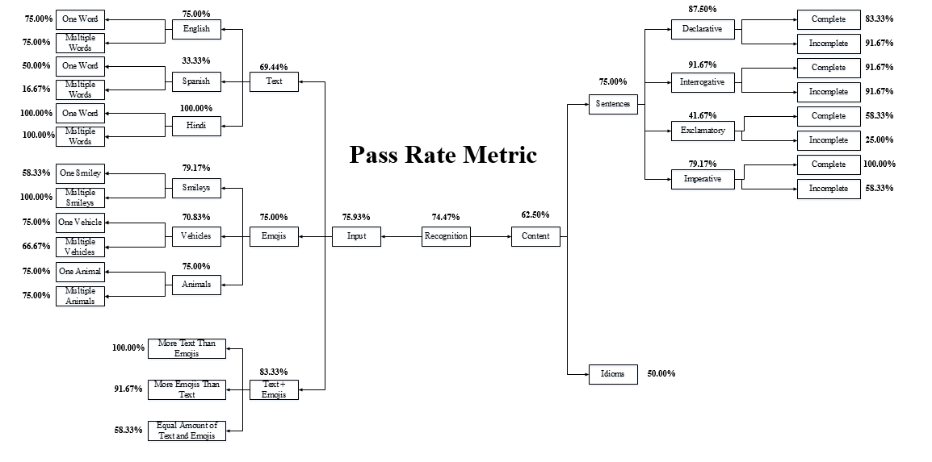
AI System Testing – A Case Study – Google Allo
Total Pass Rate: 74.47%
100 x (Total Pass / (Total Pass + Total Failed)) = 100% x (210 / (210 + 72))
Same formula applies to all nodes

Slide 11
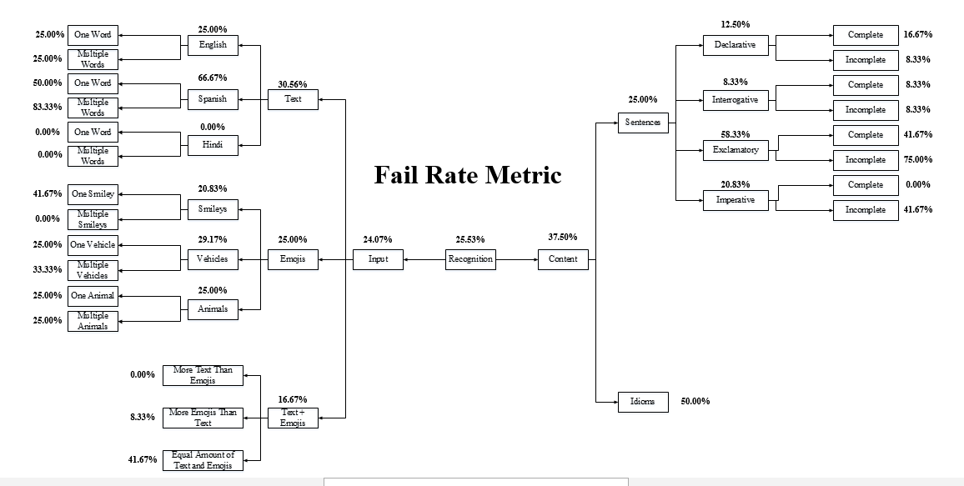
AI System Testing – A Case Study – Google Allo
Total Fail Rate: 25.53%
100 - Pass Rate = 100 - 74.47
Same formula applies to all nodes

